Slide 1
DESIGN AND SIMULATION OF SOLAR-POWERED STREET LIGHTING SYSTEM USING LTSPICE
BY GROUP 20

Slide 2
TABLE OF CONTENT
INTRODUCTION
LIST OF GROUP MEMBERS
AIM OF THE PROJECT
LIST OF COMPONENTS NEEDED
METHODOLOGY
EXPERIMENTAL RESULTS
DEDUCTIONS
CONCLUSION

Slide 3
INTRODUCTION
Street lighting is a crucial aspect of urban infrastructure, providing numerous benefits to pedestrians, drivers, and the community as a whole. The primary function of street lighting is to illuminate public spaces, ensuring safety, security, and visibility.
Energy-efficient options like LED lighting also reduce carbon emissions, contributing to a more sustainable environment. Solar-powered street lights offer a sustainable solution for urban lighting, one of which is reducing reliance on fossil fuels. Hence, the focus of this project is the solar-powered street lighting system.

Slide 4
LIST OF GROUP MEMBERS
1. ERINKITOLA ABDULBAASIT IYANUOLUWA (210408062 - COMPUTER ENGINEERING)
2. EMEKA SAMUEL IFEAYINCHUKWU (210403022 - ELECTRICAL ELECTRONICS ENGINEERING)
3. EZEANOWI CHISOM SHEDRACK (210403103 - ELECTRICAL ELECTRONICS ENGINEERING)
4. EZINMA JOSHUA CHUKWUEMEKA (210403112 - ELECTRICAL ELECTRONICS ENGINEERING)
5. ESEKHAIGBE LORDSON (210407065 - SYSTEMS ENGINEERING)
6. EZERIOHA-ETHELBERT DOMINION KENECHUKWU (230403534 - ELECTRICAL ELECTRONICS ENGINEERING)
7. EYINLE ADEDOLAPO CATHERINE (210403037-ELECTRICAL AND ELECTRONICS ENGINEERING)
8. ETOP-ARCHIBONG EDIDIONG (230407534- SYSTEMS ENGINEERING)
9. EZE DANIEL (210407109 – SYSTEMS ENGINEERING)
10. EZENDIOKWERE CHRISTOPHER (210403504 - ELECTRICAL ELECTRONICS ENGINEERING)

Slide 5
LIST OF COMPONENTS NEEDED
Solar Panel (represented with an 18V Source)
Schottky Diode
Battery
Resistors
Capacitor
Inductor
Pulse Width Modulation Signal Generator
N-MOSFETs
Voltage Regulators
Light-Emitting Diode (LED)
Comparators
AND-Gate
VCVS (Voltage-Controlled Voltage Source)
PIR Motion Sensor

Slide 6
AIM OF THE PROJECT
To calculate the solar panel and battery sizing
To design and simulate a complete solar power circuit (including solar panel, charge controller, battery, and lighting system) that automatically switches the LED street lights on during dark or low light conditions, incorporating energy-efficient components, such as LEDs and PIR motion sensors, with a switching mechanism (using diodes or transistors).
The goal is to achieve at least a 30% reduction in energy consumption compared to conventional systems without motion detection.

Slide 7
METHODOLOGY
Before the design and simulation of the street lighting system, the required solar panel size, solar charge controller (Maximum power point tracking)/ BMS (Battery Management system) and battery storage capacity to ensure continuous operation of 12V, 20 Watts, street lightening system for a minimum of 12 hours under low sunlight conditions were calculated.
Taking this part of the world as a case study, the number of hours for which street light is needed is less than 12 (worst case scenario is often around 6:30pm – 6:30am or 7:00 pm – 7:00 am i.e. 12 hours). As a result, to minimize cost whilst efficiency in performance is still assured, we shall work with 12 hours in our design, even though that is the minimum requirement.
After the calculations, the sizes of the key components needed were deduced to be:
150W Solar Panel
12.5A MPPT Charge controller.
37.5Ah, 12V lithium-ion battery
20W LED

Slide 8
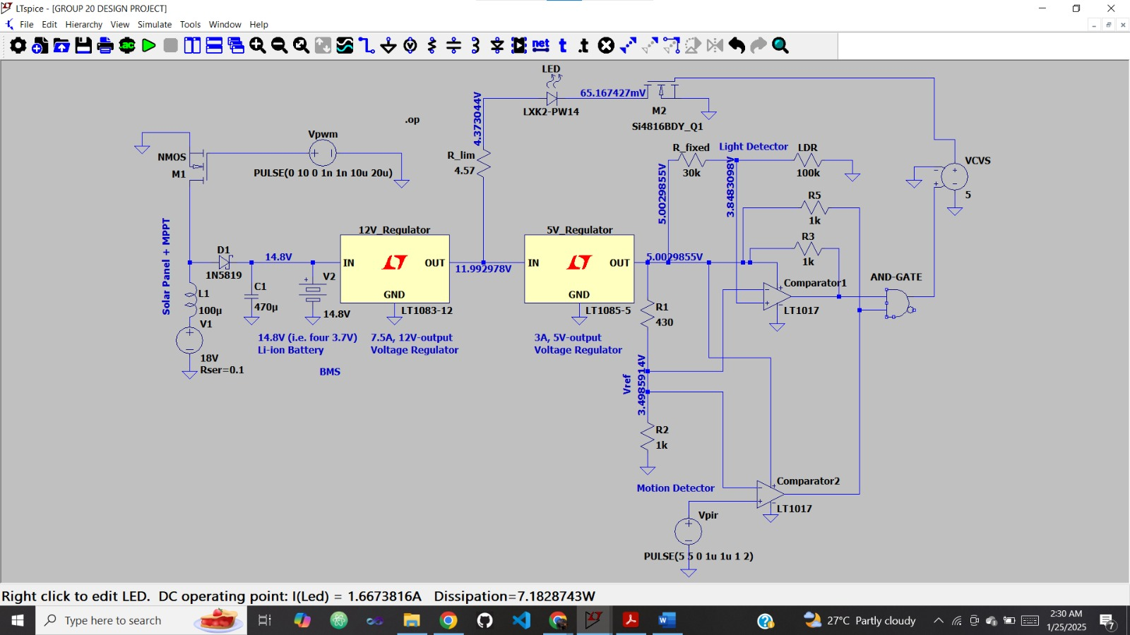
EXPERIMENTAL RESULTS
Case 1: When there is darkness (R_ldr = 100kilo-ohms) and there is motion (Vpir = V(n015) = 5V), I_led = 1.667A (LED turns on). This can be deduced in the transient analysis when time t = 0-1s, 2s-3s, …

Slide 9
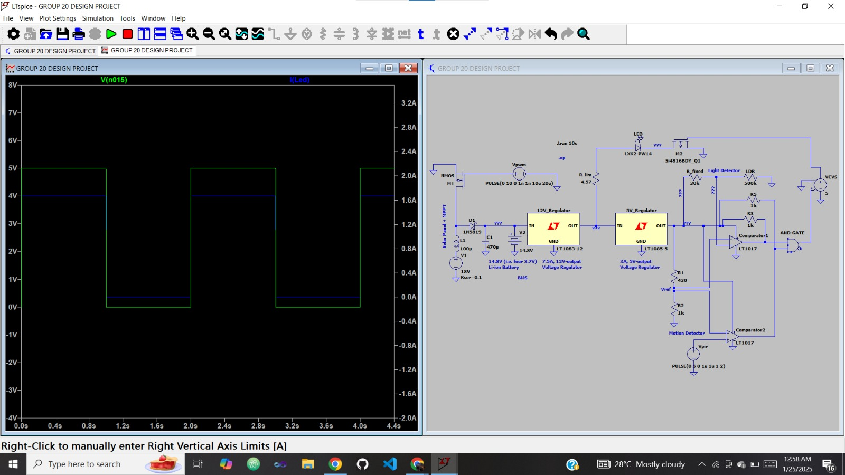
EXPERIMENTAL RESULTS

Slide 10
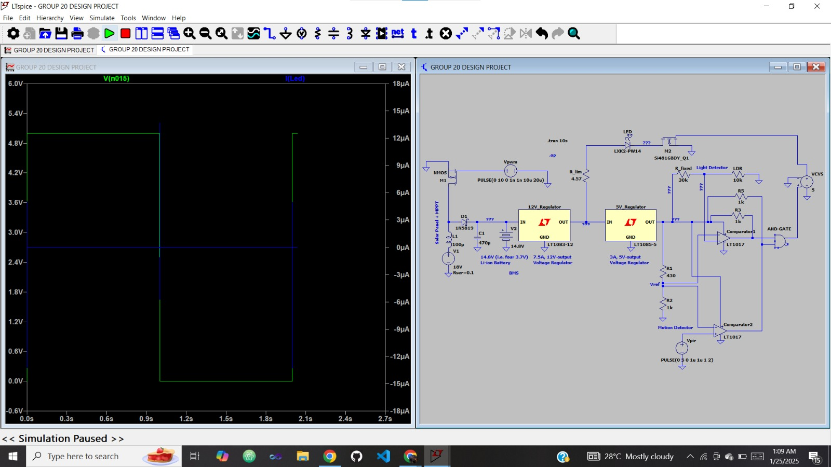
EXPERIMENTAL RESULTS
Case 2: When there is no darkness (R_ldr = 10kilo-ohms) and there is motion (Vpir = V(n015) = 5V), I_led = 0 (LED is off). This can be deduced in the transient analysis when time t = 0-1s, 2s-3s, … However, at 1s, 2s, … the current is apparently not just 0A. This is due to the pulse width modulation signal generator used in the MPPT design. The PWM signal generator produces transient currents due to switching effects in the pulse voltage used simulating motion detection.

Slide 11
EXPERIMENTAL RESULTS
Case 3: When there is darkness (R_ldr = 100kilo-ohms) and there is no motion (Vpir = V(n015) = 0), I_led = 0 (LED is off). This can be deduced in the transient analysis when time t = 1s-2s, 3s-4s, …

Slide 12
EXPERIMENTAL RESULTS
Case 4: When there is no darkness (R_ldr = 10kilo-ohms) and there is no motion (Vpir = V(n015) = 0), I_led = 0 (LED is off).
This can be deduced in the transient analysis when time t = 1s-2s, 3s-4s, … Though, at 1s, 2s, …, as stated in Case 2, the current is apparently not just 0A. This is due to the pulse width modulation signal generator used in the MPPT design. The PWM signal generator produces transient currents due to switching effects in the pulse voltage used simulating motion detection.

Slide 13
DEDUCTIONS
The ratio of night commuters to daylight commuters even in demanding times is less than 1:2. Taking 12 hours of daylight and 12 hours of night time for instance; without motion detection, the streetlight system will work throughout the night for 12 hours, while with the integration of motion detection into the system, the streetlight works for about 6-7 hours per night. This means that in our design where the use of motion detection is leveraged on, we were able to achieve the goal of a minimum of 30% reduction in energy consumption compared to conventional systems without motion detection.
In addition, we have been able to verify that our design is correct, owing to the fact that the efficiency of an LED is typically around 30-40%. For our design, as shown at the bottom left of the image attached to case 1 in the experiment results, the power being dissipated by the LED is 7.18W, whereas, the LED is a 20W LED. This means that despite consuming 20W power, the LED is only able to give out 7.18W which is 36% of the power consumed. This conforms with the 30-40% efficiency range expected of LEDs.

Slide 14
CONCLUSION
With this project, we are able to implement a system that combines PIR (Passive Infrared) sensor and LDR (Light-Dependent Resistor) to power a solar street light based on both the ambient light levels and detected motion. This integration allows for a control mechanism where the street light responds dynamically to changes in both lighting conditions and the presence of motion. The combined operation of these sensors not only enhances the efficiency of the lighting system but also showcases a practical application of sensor technology for responsive, adaptive illumination, and energy-saving capacity.
Most importantly, with this design and simulation, we have achieved our goal of a minimum of 30% reduction in energy consumption compared to conventional systems without motion detection.

Slide 15
THANK YOU.

